Slide 1
YEAR 9 MATHEMATICS
CAT 2 Presentation

Slide 2
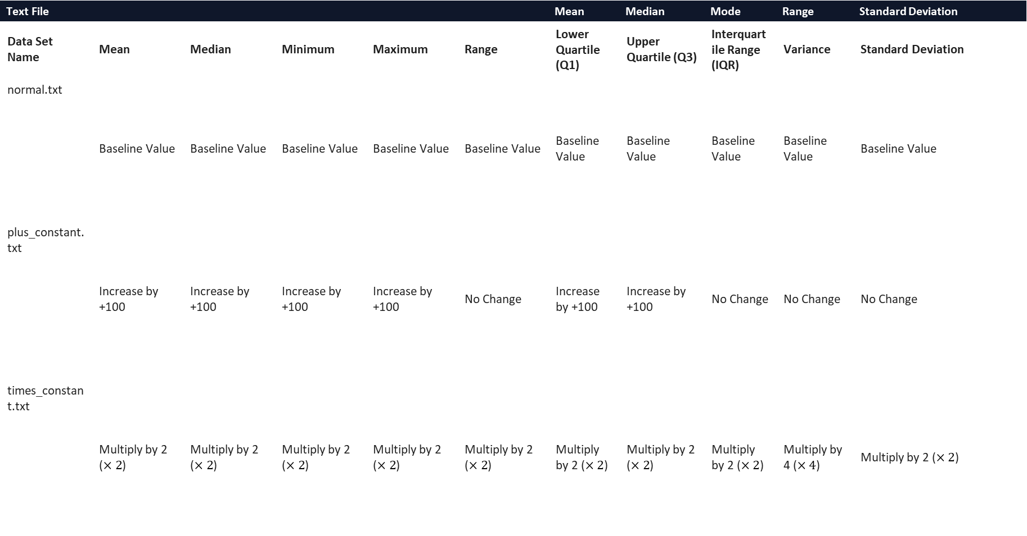
Table
Statistical Measures
Text File |  |  |  |  |  | Mean | Median | Mode | Range | Standard Deviation
Data Set Name | Mean | Median | Minimum | Maximum | Range | Lower Quartile (Q1) | Upper Quartile (Q3) | Interquartile Range (IQR) | Variance | Standard Deviation
normal.txt | Baseline Value | Baseline Value | Baseline Value | Baseline Value | Baseline Value | Baseline Value | Baseline Value | Baseline Value | Baseline Value | Baseline Value
plus_constant.txt | Increase by +100 | Increase by +100 | Increase by +100 | Increase by +100 | No Change | Increase by +100 | Increase by +100 | No Change | No Change | No Change
times_constant.txt | Multiply by 2 ($×2$) | Multiply by 2 ($×2$) | Multiply by 2 ($×2$) | Multiply by 2 ($×2$) | Multiply by 2 ($×2$) | Multiply by 2 ($×2$) | Multiply by 2 ($×2$) | Multiply by 2 ($×2$) | Multiply by 4 ($×4$) | Multiply by 2 ($×2$)

Slide 3
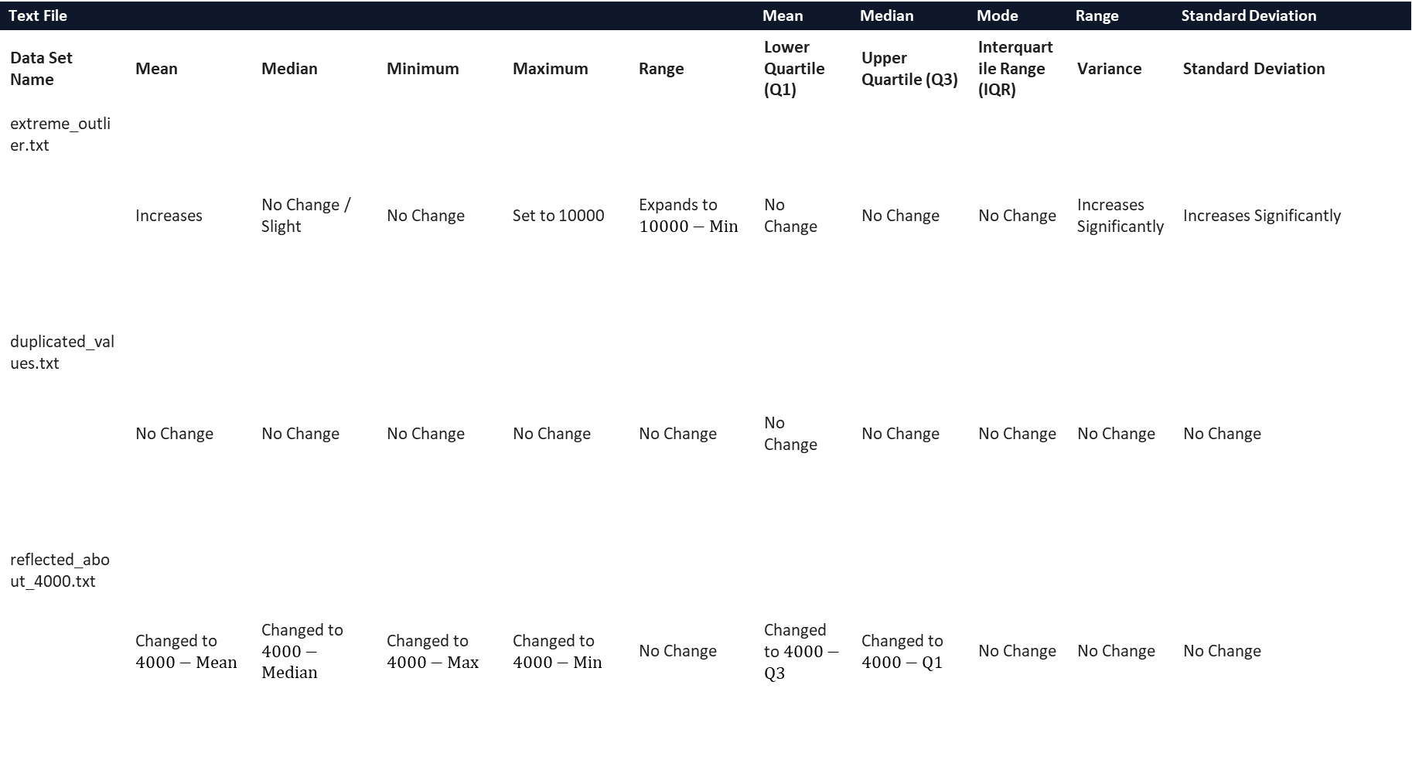
Statistical Measures
Table
Text File |  |  |  |  |  | Mean | Median | Mode | Range | Standard Deviation
Data Set Name | Mean | Median | Minimum | Maximum | Range | Lower Quartile (Q1) | Upper Quartile (Q3) | Interquartile Range (IQR) | Variance | Standard Deviation
extreme_outlier.txt | Increases | No Change / Slight | No Change | Set to 10000 | Expands to $10000−\text{Min}$ | No Change | No Change | No Change | Increases Significantly | Increases Significantly
duplicated_values.txt | No Change | No Change | No Change | No Change | No Change | No Change | No Change | No Change | No Change | No Change
reflected_about_4000.txt | Changed to $4000−\text{Mean}$ | Changed to $4000−\text{Median}$ | Changed to $4000−\text{Max}$ | Changed to $4000−\text{Min}$ | No Change | Changed to $4000−\text{Q3}$ | Changed to $4000−\text{Q1}$ | No Change | No Change | No Change

Slide 4
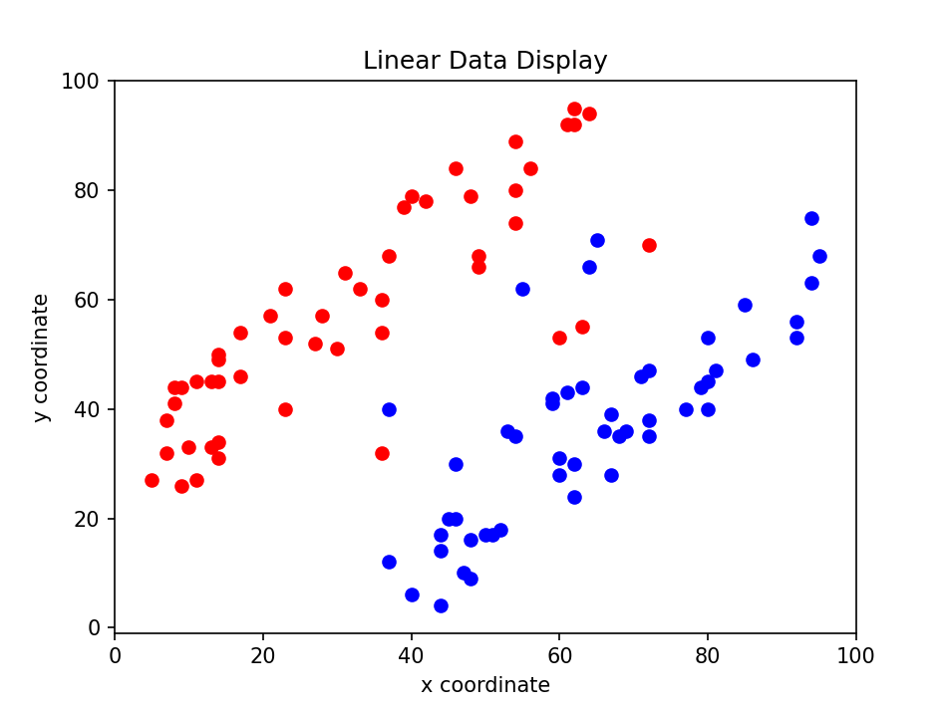
Screenshot
data_display.py

Slide 5
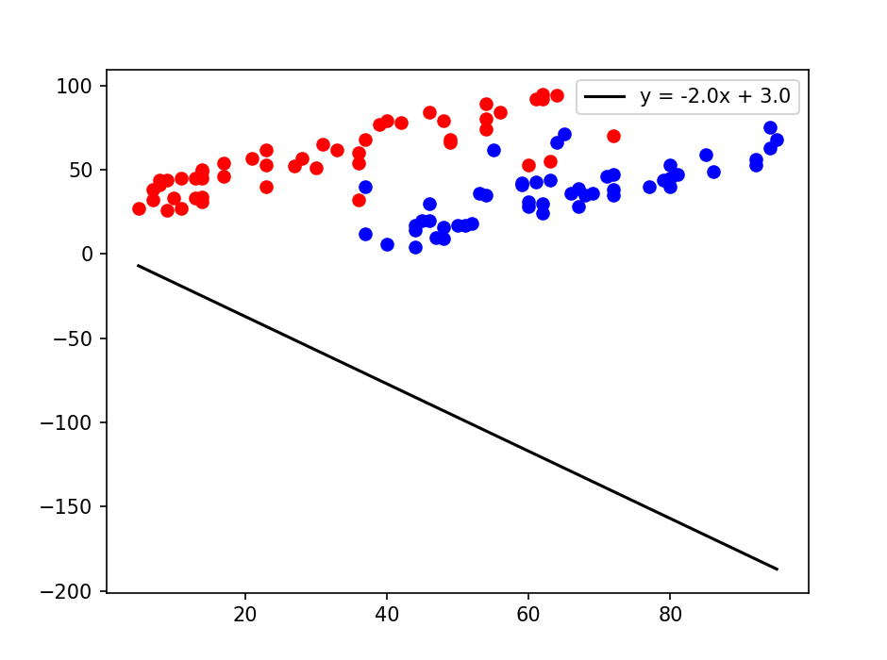
Screenshot
manual_classify.py

Slide 6
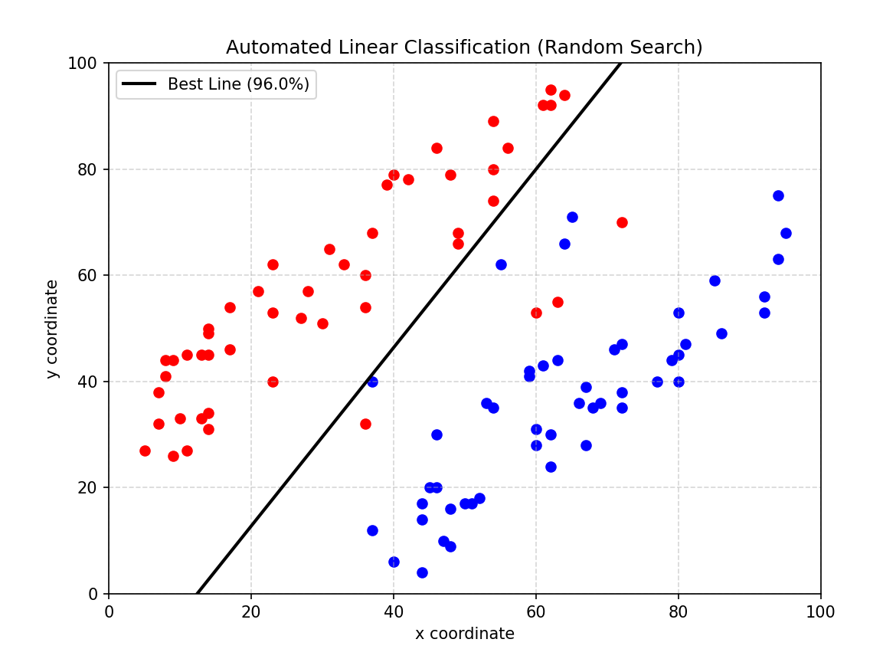
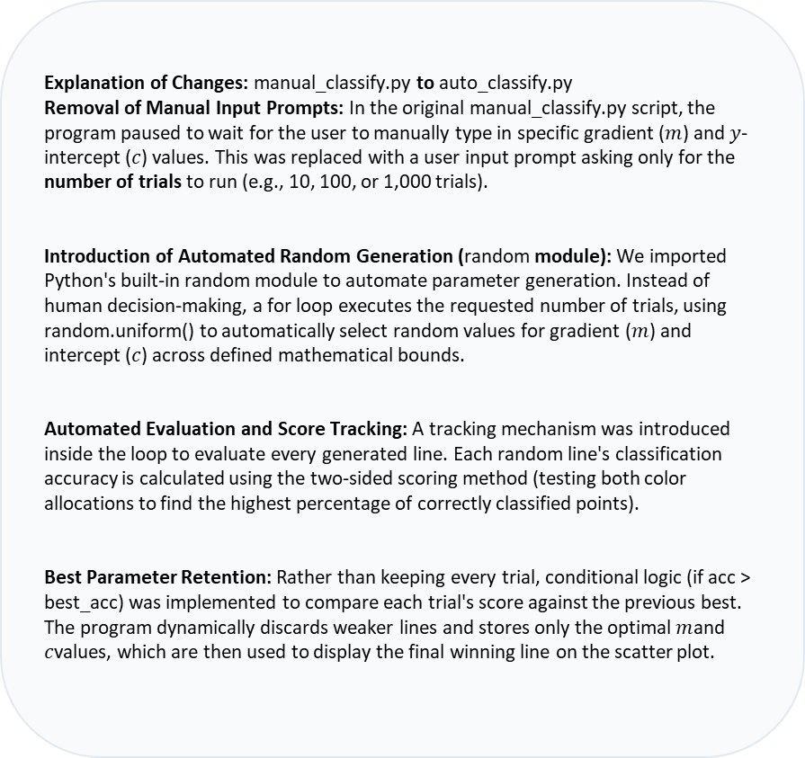
Screenshot & Explanation
auto_classify.py
Explanation of Changes
Explanation of Changes: manual_classify.py to auto_classify.py
Removal of Manual Input Prompts: In the original manual_classify.py script, the program paused to wait for the user to manually type in specific gradient ($m$) and $y$-intercept ($c$) values. This was replaced with a user input prompt asking only for the number of trials to run (e.g., 10, 100, or 1,000 trials).
Introduction of Automated Random Generation (random module): We imported Python's built-in random module to automate parameter generation. Instead of human decision-making, a for loop executes the requested number of trials, using random.uniform() to automatically select random values for gradient ($m$) and intercept ($c$) across defined mathematical bounds.
Automated Evaluation and Score Tracking: A tracking mechanism was introduced inside the loop to evaluate every generated line. Each random line's classification accuracy is calculated using the two-sided scoring method (testing both color allocations to find the highest percentage of correctly classified points).
Best Parameter Retention: Rather than keeping every trial, conditional logic (if acc > best_acc) was implemented to compare each trial's score against the previous best. The program dynamically discards weaker lines and stores only the optimal $m$and $c$values, which are then used to display the final winning line on the scatter plot.

Slide 7
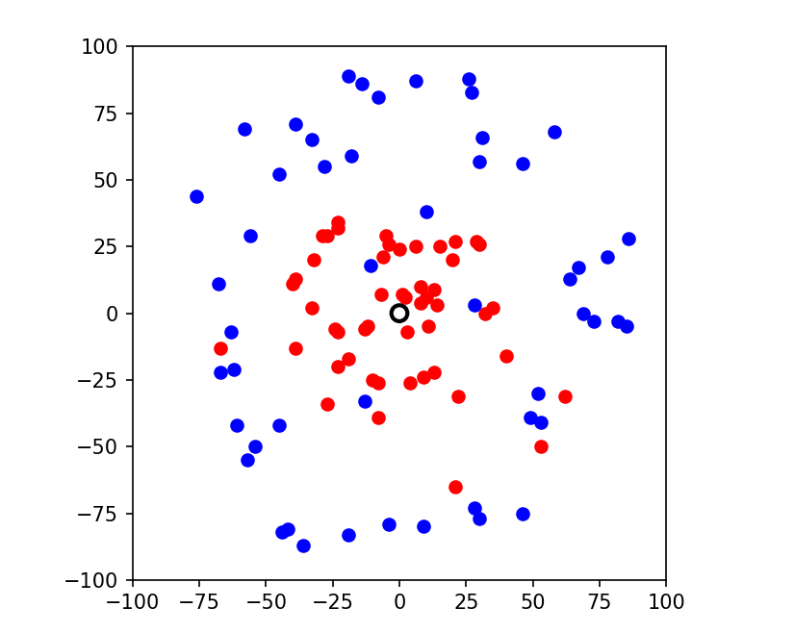
Screenshot
manual_non_linear.py

Slide 8
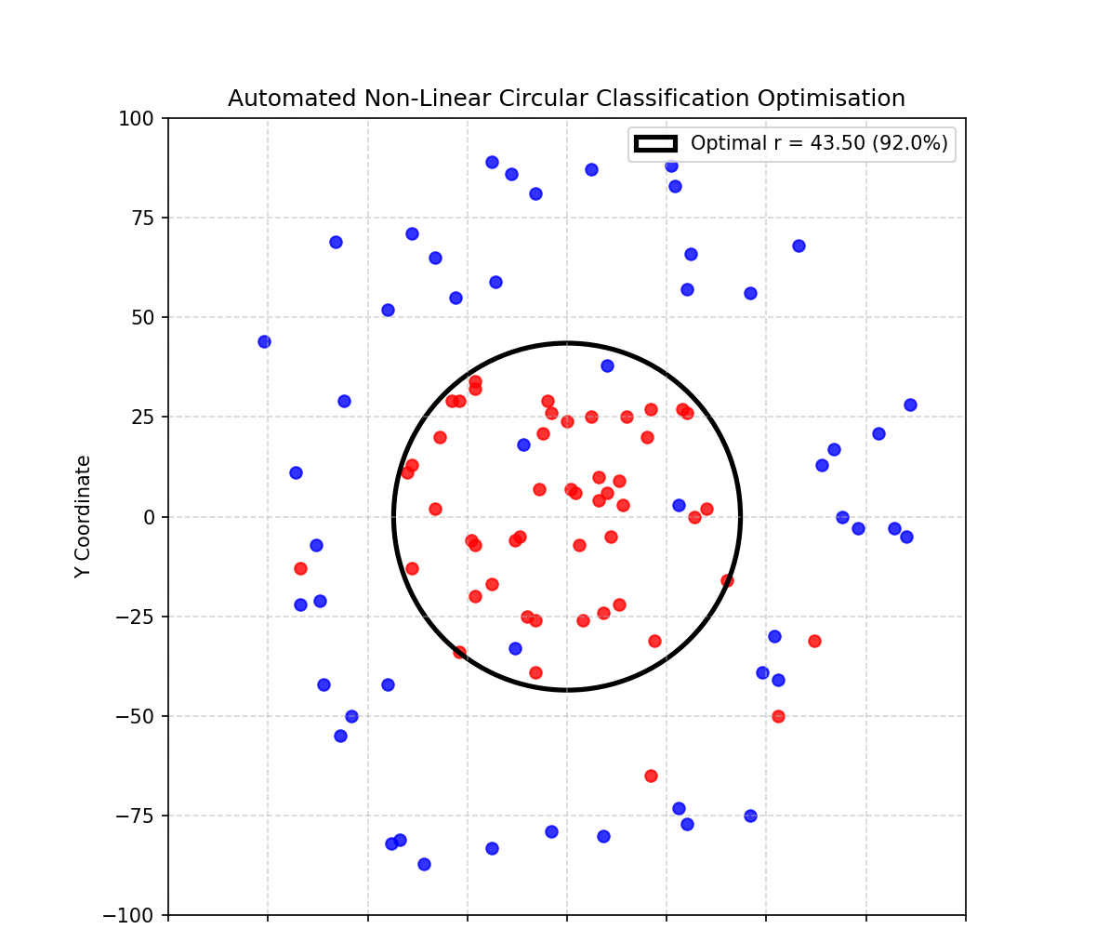
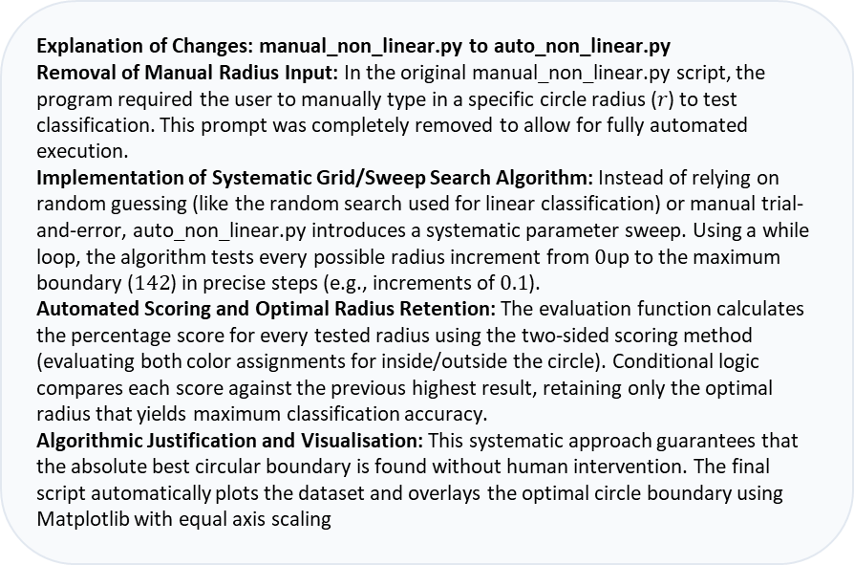
Screenshot & Explanation
auto_non_linear.py
Explanation of Changes
Explanation of Changes: manual_non_linear.py to auto_non_linear.py
Removal of Manual Radius Input: In the original manual_non_linear.py script, the program required the user to manually type in a specific circle radius ($r$) to test classification. This prompt was completely removed to allow for fully automated execution.
Implementation of Systematic Grid/Sweep Search Algorithm: Instead of relying on random guessing (like the random search used for linear classification) or manual trial-and-error, auto_non_linear.py introduces a systematic parameter sweep. Using a while loop, the algorithm tests every possible radius increment from $0$up to the maximum boundary ($142$) in precise steps (e.g., increments of $0.1$).
Automated Scoring and Optimal Radius Retention: The evaluation function calculates the percentage score for every tested radius using the two-sided scoring method (evaluating both color assignments for inside/outside the circle). Conditional logic compares each score against the previous highest result, retaining only the optimal radius that yields maximum classification accuracy.
Algorithmic Justification and Visualisation: This systematic approach guarantees that the absolute best circular boundary is found without human intervention. The final script automatically plots the dataset and overlays the optimal circle boundary using Matplotlib with equal axis scaling

Slide 9
Algorithm
Algorithm Description
Description of the Optimisation Algorithm: To approximate the maximum turning point of any negative quadratic curve without relying on direct algebraic formulas, the script implements an iterative Hill Climbing algorithm.
Starting Position: The program selects a random initial 𝑥-coordinate within a defined search space (e.g., between −500and 500).
Movement Logic: At the current position, the algorithm evaluates neighbouring points to the left and right by testing step increments. If a neighbouring point yields a higher 𝑦-value, the climber moves in that direction.
Accuracy and Tolerance: To ensure high precision, the step size dynamically halves whenever the peak is bracketed. The loop continues until the step size satisfies the required precision tolerance bound of 1/√(|𝑎|), guaranteeing that the final approximate peak is accurate and reliable.
Peak Finding Logic
Ensuring Accuracy

Slide 10
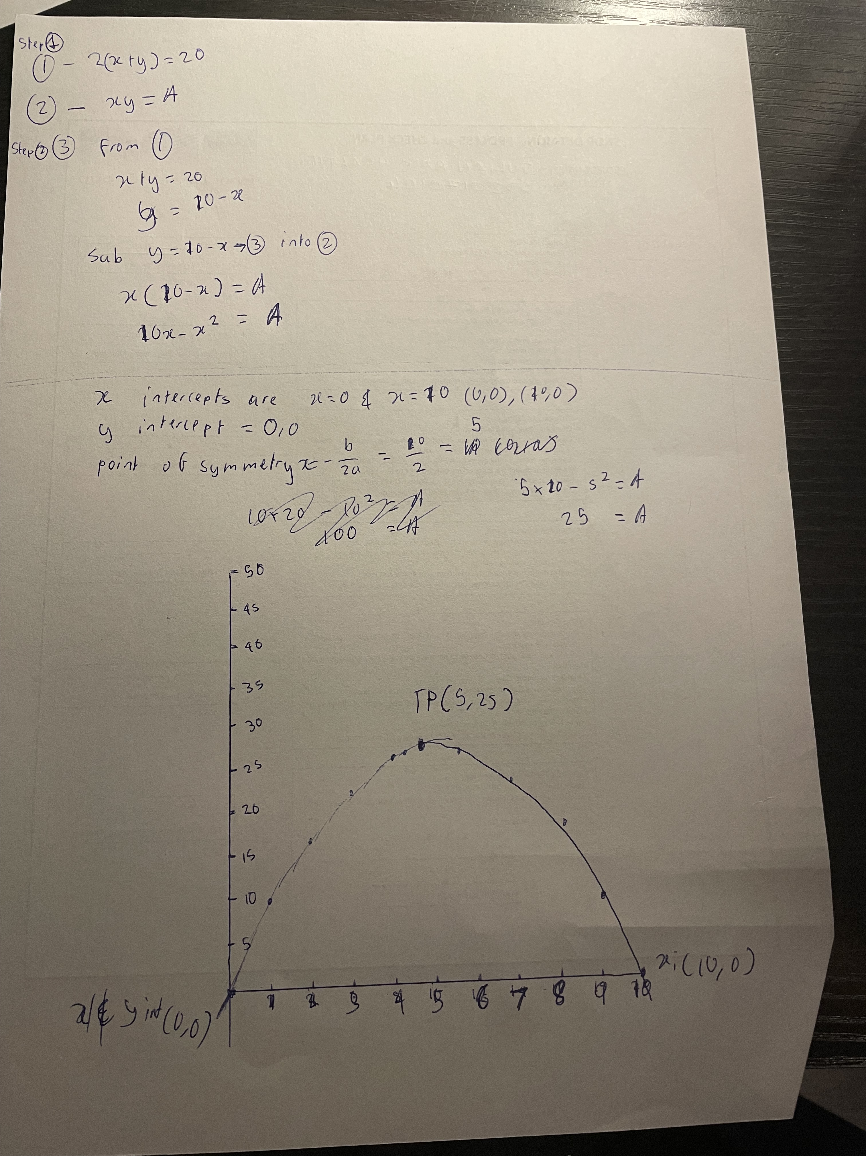
Working
Handwritten Working & Solutions

Slide 11
Questions?

